Slide 1

Southwest Creations Collaborative
Quarterly Board of Directors Meeting
Wednesday, January 24, 2018
1:00-4:00 PM Board Meeting @ SCC
1308 4th Street NW, ABQ, NM 87102

Slide 2
BOARD MEETING AGENDA
(1:00- 1:20)
ATTENDANCE - Clare
ANNOUNCEMENTS – Introduce guest, Lawrence Rael - Tracy
APPROVAL OF MINUTES – Karen
(1:20-1:40)
PROGRAMS – Sasha Pellerin and Hacia Team
(1:40 – 2:30)
FINANCIAL – Joann, Linnea Susan
(2:30 – 2:35)
BREAK
(2:35 – 2:50)
PRODUCTION/BUILDING UPDATE – Susan
(2:50 – 3:30)
COMMITTEE UPDATES
(3:00 – 3:50)
MARKETING/VISIBILITY – Alexis Tappan
(3:50 – 4:00)
OTHER BUSINESS – Clare

Slide 3


Southwest Creations Collaborative Balance Sheet
as of December 31, 2017

Slide 4


Southwest Creations Collaborative Income Statement for the Quarter
Ended December 31, 2017

Slide 5
2017Highlights

Slide 6
Observations & Conversation Topics
Balance sheet shows reduced cash and receivables but strong debt reduction.
Cash decrease since last quarter is due to spending of grant funds, reduced production revenue and increased staffing cost.
Positive Fund Balance and YTD Loss is comparable to prior year.
Current Ratio is 2. 3 or better is the goal.
At year end Production Revenue is 105% of budget.
Net operating loss was 11,800, combined net loss was 33,030 (due to depreciation)

Slide 7
Financial Dashboard – as of December 31, 2017

Slide 8
DASHBOARD OBSERVATIONS
  Dashboard reflects “sustainability” of the organization
  YTD Budget vs Actual
    Organizational net income under budget by about $33,030
  Program revenue recorded as grants are spent
    30% of G&A is used for Programs
    Production revenue has covered $157,182 in program expenses, which is 29% of all program expenses
  Production
    Production Revenue is performing over budget for the year, however, gross margin is under creating a slightly under-budget production net income. GPM % is 30%, in line with historic performance.
    70% of G&A is used for Production
    Production paid for 29% of the total Program costs
      Historical Data – fluctuation is an effect of amount of grant funding
        2016 Production paid 13% of total Program costs
        2015 Production paid 1% of total Program costs
        2014 Production paid 10% of total Program costs
    The past two months, (November & December) contract revenue was lower than targeted, and this contributed to the combined net loss of ($33,030) YTD. Note: net operating loss before depreciation was $11,080.

Slide 9
Production Revenue Q4 2017

Slide 10
Production Revenue 2014–YTD 2017

Slide 12
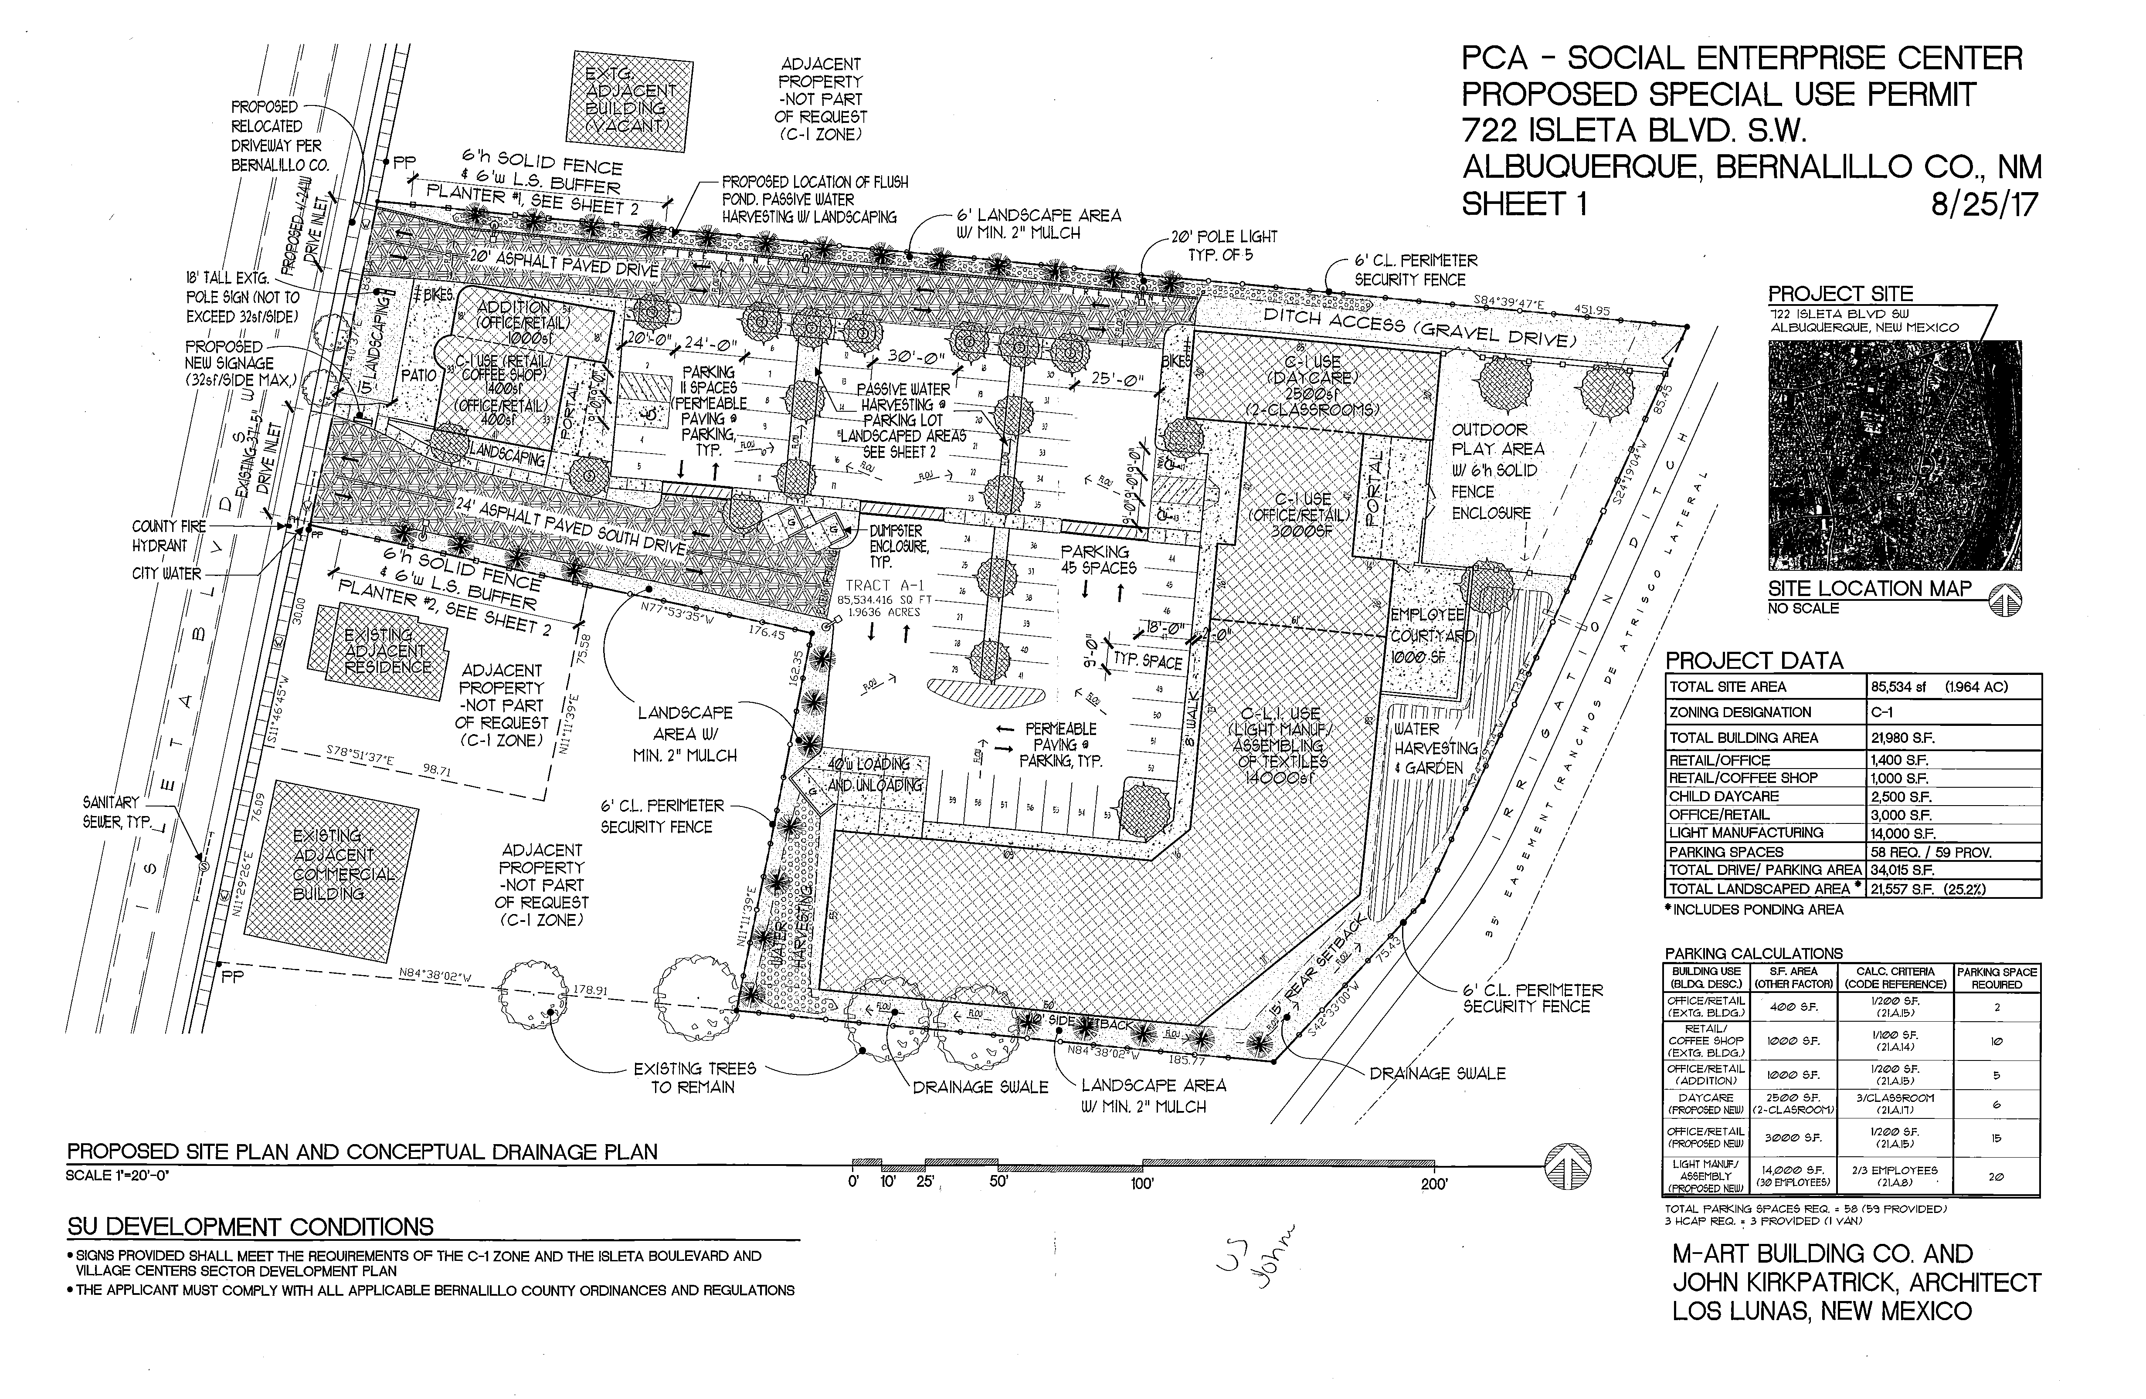

Slide 13
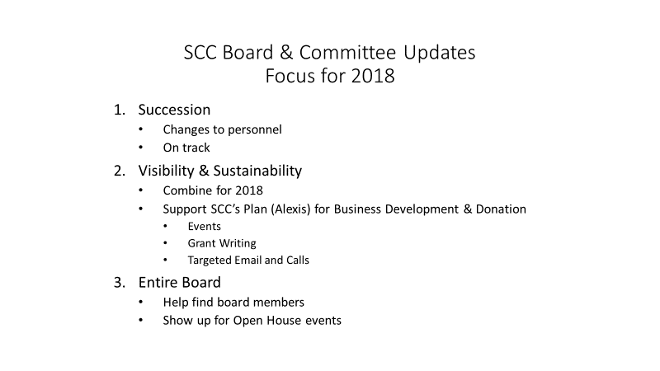

Slide 14
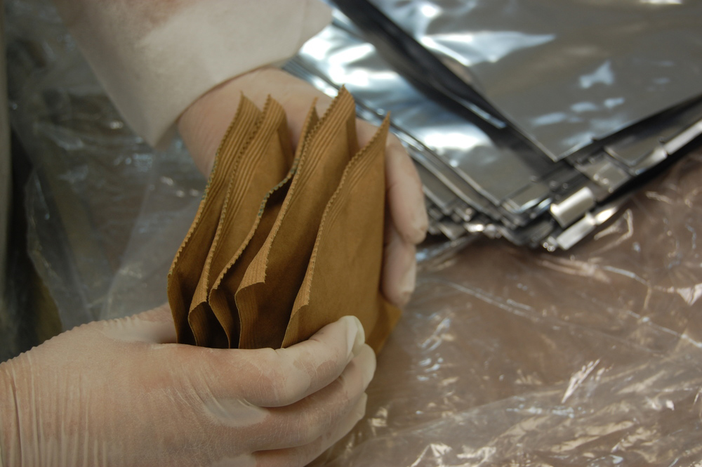
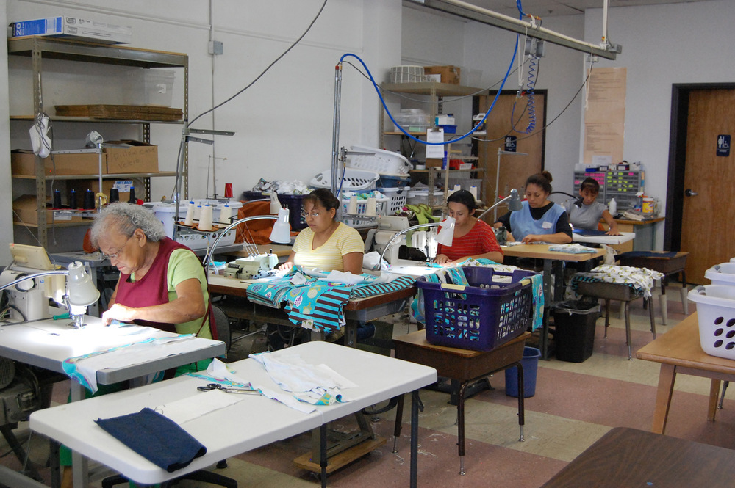
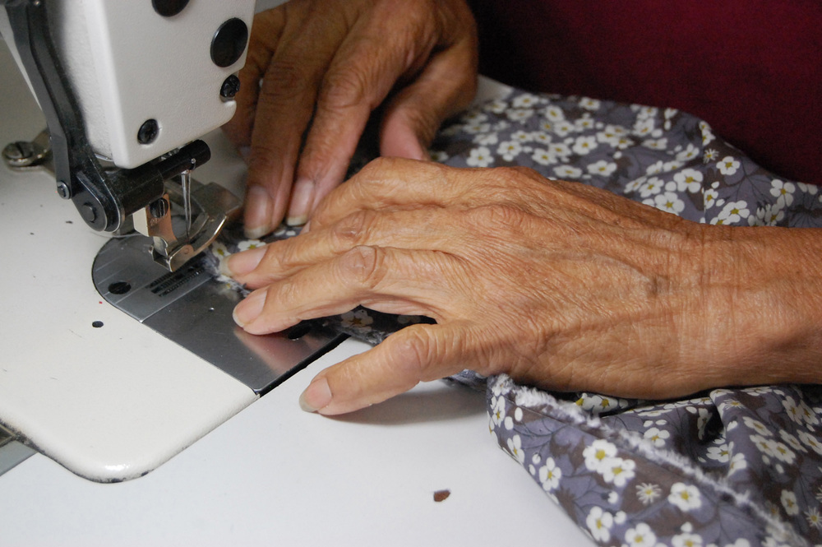
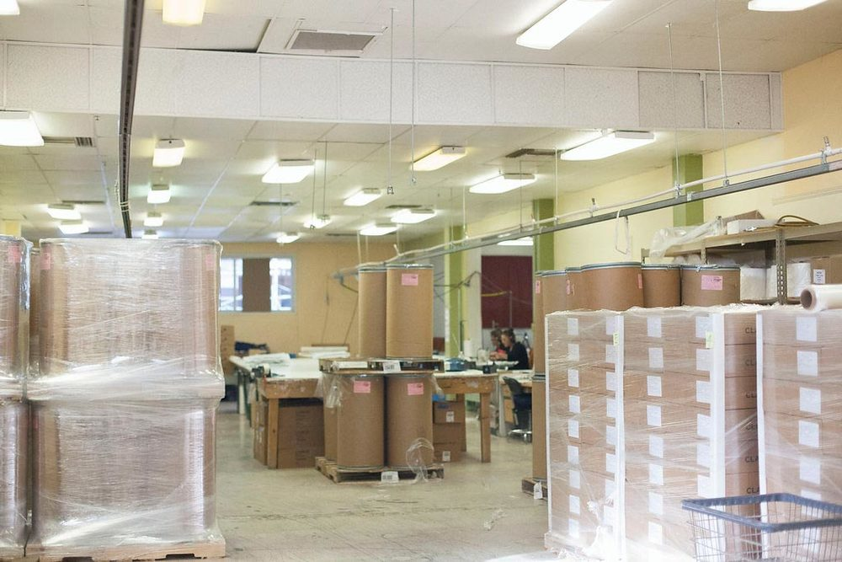
Marketing Plan
Visibility Framework
Southwest Creations Collaborative

Slide 15
Goal
Raise visibility, grow client base and drive business sustainability by:
Generating Community Interest
Generating Community Support
Generating Client Interest
Supporting New Building Launch

Slide 16
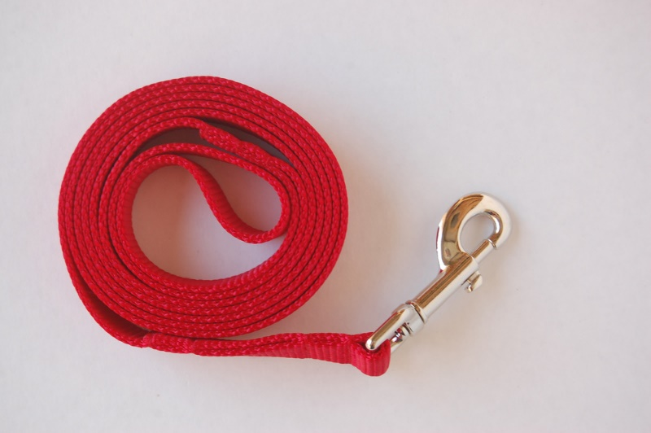
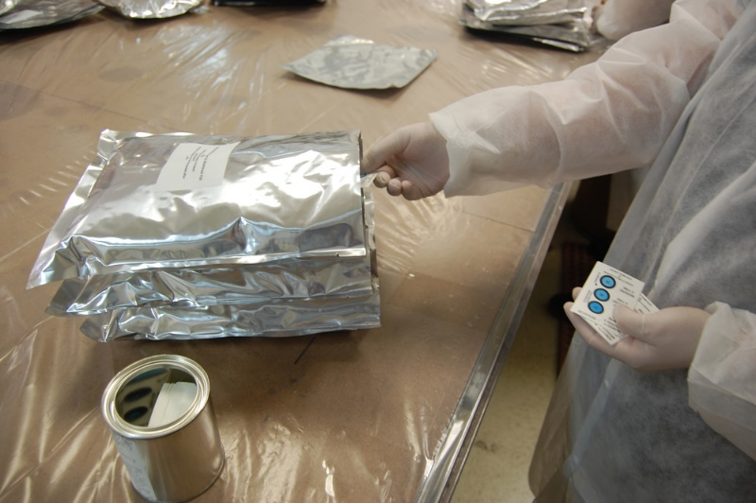
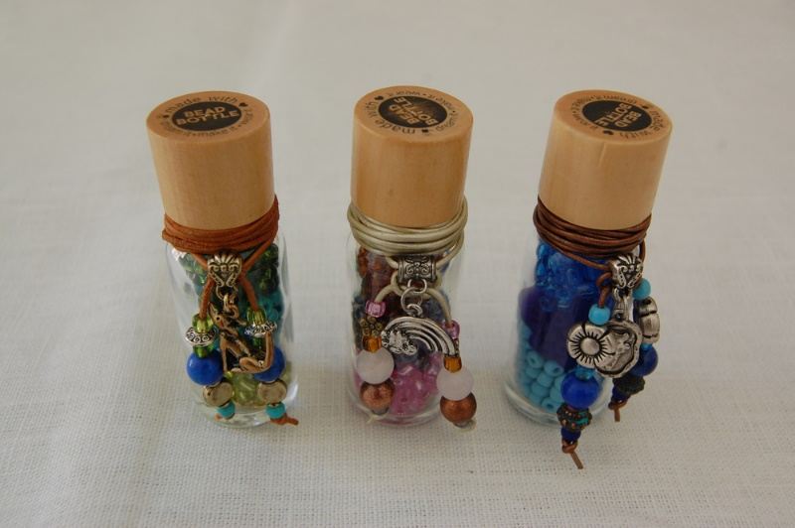
Strategy Summary
Create unique opportunities to showcase SCC and its staff/board leadership to specific target audiences.

Slide 17
Quarterly Friendraising Events
SCC board members, staff and friends will invite community leaders, influencers, potential donors and potential clients.
Events will be limited to approximately 10 people each.
Event Components
  Brief SCC introduction
  Tour of SCC
  Hacia presentation
  Q&A and close with Executive Director
Proposed Dates/Themes
  Friday, February 16 (Creativity)
  Friday, May 18 (Economic Development)
  Friday, September 21 (Social Enterprise - Institutions such as UNM, CNM, APS)
  TBD (Manufacturing in partnership with MEP and Manufacturing Day)

Slide 18
Showcase SCC to Community
Deepen connections with business/community influencers through attendance at community events by Executive Director and Board of Directors
  Entrepreneurship Events
  Economic Forum
  Albuquerque Economic Development
  Albuquerque Hispano Chamber of Commerce
  1 Million Cups
  Coffee and Creatives
  Ethics in Business Awards

Slide 19
Board of Directors Needs
Friendraisers
  Identify potential attendees for Friendraisers
  Invite professional/personal connections to Friendraisers quarterly
  Attend two friendraisers/year
SCC Community Showcase
  Identify business and community events to increase SCC exposure
  Create opportunities for SCC to attend/speak at event
  Join SCC at events to make connections/introductions
Utilize SCC script to emphasize key concepts when discussing SCC in community.

Slide 20
Social Media
Increase visibility and awareness to generate new clients and community support
Instagram: “Work with Us” campaign (B2B)
  Goal: Rebrand page and increase followers
  Focus: Sewing/Fabrics/Production
Facebook: Community-building
  Goal: Increase followers to 580, increase engagement
  Focus: Get to know SCC, job opportunities, about customers/employees, Hacia
Metrics
50↑ in Facebook fans
100↑ in Instagram fans

Slide 21
Communications Support
Review and Update Communications Materials
Strategic Website Consulting/Support/Updates
Spokesperson/Host (as appropriate)
Writing and Editing
Strategic Communications Insight
Board Support Materials
Donor Relations Materials

Slide 22
Long-Term Communications
Support South Valley Building Initiative
  Communications
  Groundbreaking
  Grand Opening
Support Capital Campaign
  Communications Materials
  Board Materials

